Slide 1


Slide 2

It’s been long time coming (now it’s here)
“The need for a sound social and political education…has never been so great. Without it, our young people are forced to operate in the social and political world without the skills and insights that they need to be in control of their own destiny” (Kathleen Lynch, 2000: 1).

Slide 3

Some countries build monuments,
Some build active, informed, reflective citizens
Image (cc) Ronald Woam, flickr

Slide 4
The big ideas
See the strange in the familiar
See social systems and structures in operation (in their own lives)
A curriculum of contested ideas
Data, Data, Data, Data…
[We have]“only interpreted the world in various ways; the point is to change it”

Slide 5
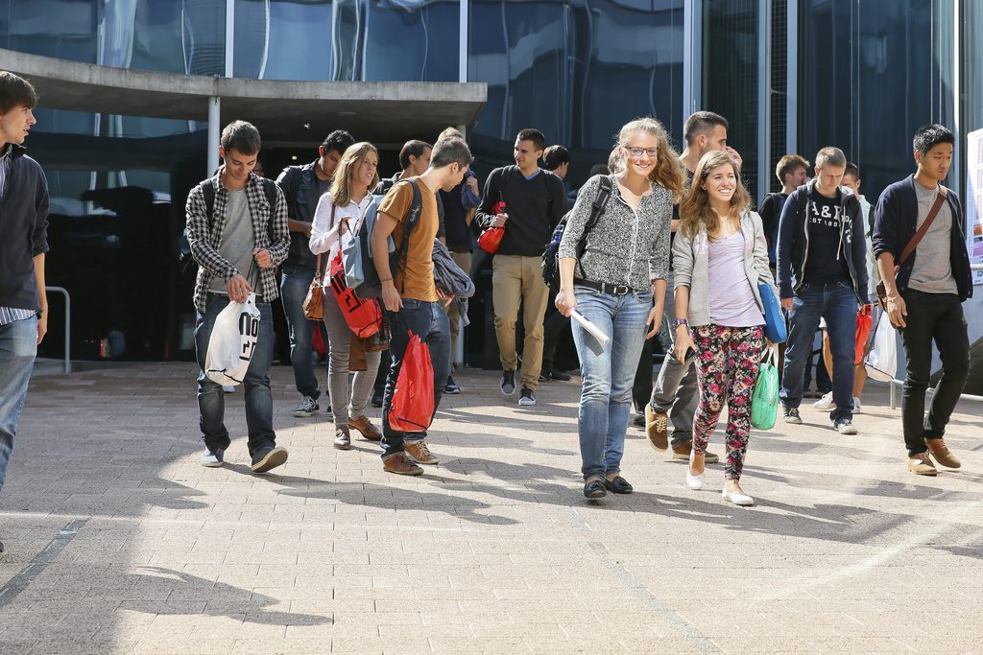
Comparative data…
For how many people can you see their leg wear?
How many are wearing:
Jeans
Leggings
Other trousers
Skirt
Dress
Other?
Image: Alan Herzog, EPFL

Slide 6
Micro questions
  How valid and reliable is our study?
  Are the findings of our (small) study surprising?
  How do you explain the patterns we see?
Big questions
  Why do we act in such regular, predictable ways?
  Why do we tend not to notice?

Slide 7
“Seeing the strange in the familiar”
Culture
  “Abilities, notions and forms of behaviour that people have acquired as members of society, [and] a system of meanings that was largely shared by a population” (Thomas Hyland Eriksen, 1995)
  The things we do, the ideas we hold, and what these things mean
  Because we think it is “normal” we tend not to see it
  Using comparative data, quantitative and qualitative

Slide 8



Big Ideas, key thinkers (Topic 7)
Who are ‘we’ (and who are ‘they’)?
Does ‘our’ culture really differ from ‘theirs’?
Imagined Communities, Globalisation, Cosmopolitanism, Orientalism, ‘Clash of Civilisations’…
Thomas Hylland Eriksen, Kwame Anthony Appiah, Benedict Anderson, Edward Said, Samuel Huntington

Slide 9
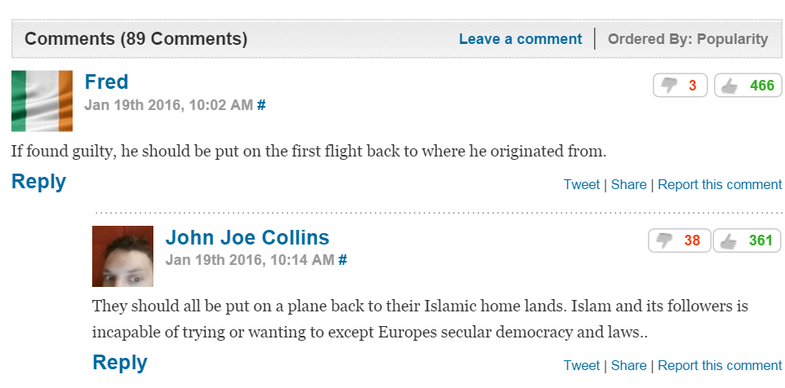
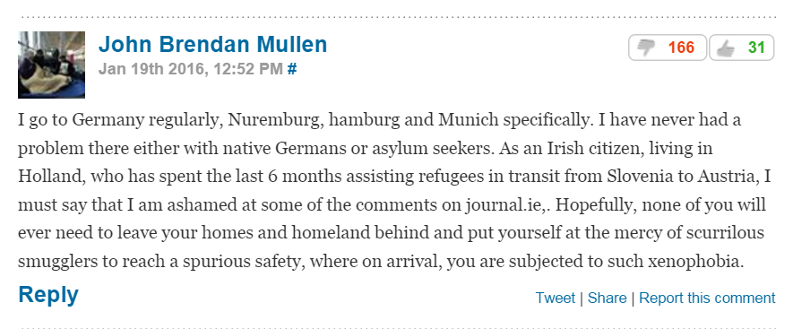
Selected comments from thejournal.ie 19th Jan 2016
Students are already having these conversations...

Slide 10
The big ideas…
“See strange in the familiar”
See social systems and structures
Reflective, informed, action
Data, data, data, data
Contested ideas

Slide 11
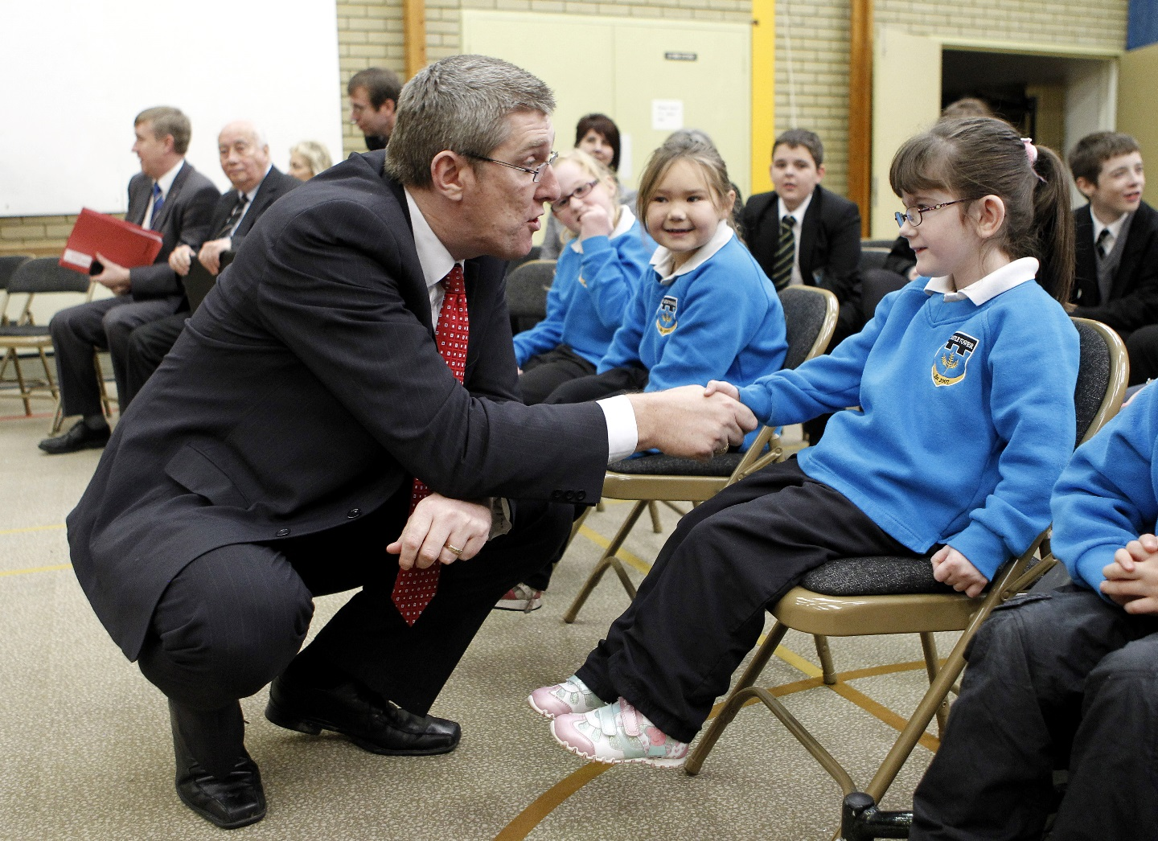
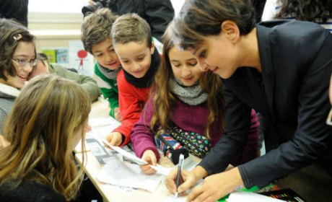
Another comparison: Spot the differences
Najat Vallaud-Belkacem, French Minister for Education
meets school children
Image: causeur.fr
John O’Dowd Northern Ireland Education Minister
meets school children
Image: flickr (cc) NI Executive

Slide 12
Contested ideas - Gender (Topic 2 and 5)
Women make up…
15% Irish Dáil
What is discrimination (implicit, explicit)?
What is patriarchy and is there evidence that we live in one?
Should the state do something about it?
Does state action infringe on other rights?
John Locke, Robert Nozick, Sylvia Walby, Kathleen Lynch
19.5% Northern Irish Assembly
27% French Parliament
Source: quotaproject.org & Belfast Telegraph

Slide 13
More contested ideas- Making Rules (Topic 1)
“Describe the process of decision‐making …in relation to:
One aspect of school rules related to safety, (e.g. fighting or bullying)
One aspect of school rules not related to safety (e.g. school uniform rules)”
School Uniforms,
Policy Decisions
Dimensions of Power, Separation of powers, Social contract, Limits to government,
Thomas Hobbes, John Locke, Robert Nozick, Karl Marx,

Slide 14
More contested ideas- Making Rules (Topic 1)
 | % pupils voting for class representatives (self report) | % pupils taking part in decision making about how school is run (self-report)
Denmark | 73 | 44
England | 79 | 55
Finland | 83 | 15
Ireland | 76 | 38
Poland | 65 | 57
Switzerland | 60 | 28
From ICCS 2009, Initial Findings pg 57, 58 http://www.iea.nl/
“Describe the process of decision‐making …in relation to:
One aspect of school rules related to safety, (e.g. fighting or bullying)
One aspect of school rules not related to safety (e.g. school uniform rules)”
School Uniforms,
Policy Decisions
Dimensions of Power, Separation of powers, Social contract, Limits to government,
Thomas Hobbes, John Locke, Robert Nozick, Karl Marx,

Slide 15
The big ideas…
“See strange in the familiar”
See social systems and structures
Reflective, informed, action
Data, data, data, data
Contested ideas

Slide 16
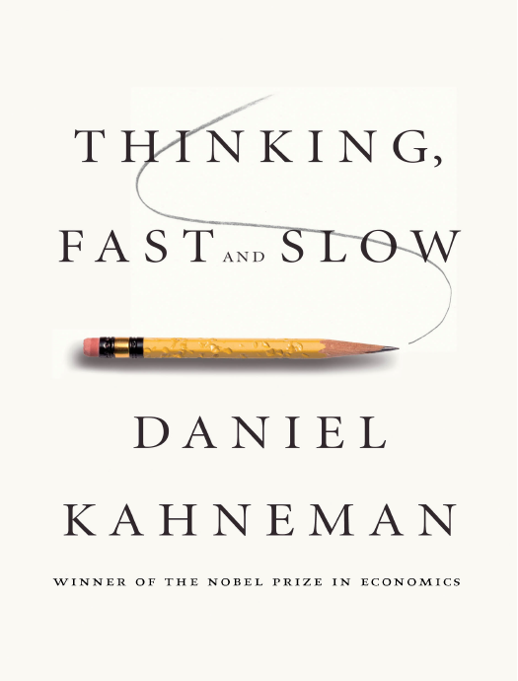
“Politics and Society” is not just debates and opinions
  Opinions need to be supported with evidence
We (humans) have a bias towards “story” over “numbers”
In social and political sciences taking a position requires rigorously collected and analysed evidence
  Quantitative
  Qualitative
Go beyond anecdotes and newspaper stories

Slide 17
To learn to read data, students will need to practice reading data
Own local environment
Make comparisons
Concepts, ideas debates
Collect and analyse data, draw conclusions
Read and interpret qualitative and quantitative data
Critique research designs
  Is it big enough?
  Does it ask the right questions?
  What assumptions does it make?

Slide 18
The big ideas…
“See strange in the familiar”
See social systems and structures
Reflective, informed, action
Data, data, data, data
Contested ideas

Slide 19
[We have]“only interpreted the world in various ways; the point is to change it”

Slide 20
What are they going to do?
Gather information
  What is out there? What are other people doing? What is their rationale?
  What sort of action is likely to be most effective?
Work with a pre-existing group, or set up their own initiative
Make a plan, then monitor and evaluate it
Work with, communicate with others
Evaluate their own development of skills

Slide 21
What kind of “action” is desired?
Why this action and not another?
What concepts, ideas inform the choice?
Ideas curriculum
Is there a need for research?
Does evidence already exist?
Data-based
Can planning and evaluation skills be practiced?
Can communication/personal effectiveness be improved?
Reflective

Slide 22
The big ideas…
“See strange in the familiar”
See social systems and structures
Reflective, informed, action
Data, data, data, data
Contested ideas

Slide 23
From dreaming the dream to living it
Many of these ideas can be found in the 2006 Background paper
We interviewed students
  What topics would be interesting?
  What teaching methods would be appropriate?
  What would be the “way in”?
Then teachers
  focus groups, NCCA committees, consultation
It is ambitious, achievable and exciting

